Slide 1
CSE7000 - INTERNSHIP A Presentation on MULTIMODAL AI STUDY ASSISTANT
Student Details
Name | Deepak N
Roll No | 20241CSG0020
Section | 5CSG01
Under the Supervision of,
Mr. Kavin Mahendhiran & Mr. Asad Mohammed Khan
Assistant Professor
Presidency School of Computer Science and Engineering
Presidency University
Name of the Program: B.Tech Computer Science & Technology
Name of the HoD: Dr. Pallavi R
Name of the Program Internship Coordinator: Mr. Teja Sirapu
Name of the School Internship Coordinators: Dr. Bhuvaneshwari Patil

Slide 2
Content
About Company or Organization
Working domain or the Technology
Objectives of the work
Methodology Used / Course Description
Results (Optional)
Conclusion

Slide 3
About Company or Organization
Header: Organization Overview & Infrastructure
Sub-header: AI Centre of Excellence – Presidency University
Host Institution: Presidency School of AI and Advanced Computing (PSAC), Presidency University, Bengaluru.
Dedicated Center: AI Centre of Excellence (AI CoE), accelerated directly by NVIDIA.
Flagship Program: 2-Week (30 Contact Hours / 2 Academic Credits) Summer Internship Program in AI & High-Performance Computing.
Industry-Grade Hardware: Powered by enterprise-grade NVIDIA H200 Tensor Core GPUs featuring 141 GB HBM3e memory and 4.8 TB/s memory bandwidth for high-performance deep learning workloads.
Lab Environment: Cloud-hosted JupyterHub GPU cluster with full CUDA 12.x, PyTorch 2.x, vLLM, and Hugging Face ecosystem support.

Slide 4
About Company or Organization
Core Focus Areas: Deep Learning (CNNs, PyTorch), Large Language Models (LLaMA 3, QLoRA, Fine-Tuning), Generative AI (Stable Diffusion XL), and GPU Optimization (FlashAttention, Mixed Precision).
Key Deliverables & Products: Development of practical capstone projects including custom LLM RAG pipelines, fine-tuned domain models, and real-time computer vision systems.
Target Audience & Learners: Undergraduate and graduate students in CS, AI, Data Science, and Engineering seeking practical GPU computing experience.
Industry & External Collaborators: Industry partner workshops, guest lectures, and external technical leadership led by partners such as Spheronix Technology.
Leadership & Execution: Directed by Dr. Robin Rohit Vincent (Head, AI CoE NVIDIA), Dr. Shakkeera L (Associate Dean), and Dr. S. Sivaperumal (Pro Vice-Chancellor).

Slide 5
Working domain or the technology
Core Technology Stack:
Large Language Models: Google Gemini 2.5 Flash API with real-time response streaming and custom exponential backoff retry mechanisms.
Application Framework: Python, Streamlit (for reactive state machine management), and PyNgrok (for cloud reverse tunneling).
Document & Vision Parsing: PyPDF, Python-Docx, Python-PPTX, and Pillow (PIL) for extracting text, layout, and visual data across 10+ file types.
Audio Synthesis & Media: Google Text-to-Speech (gTTS) and direct byte-stream multimedia handling for MP3, WAV, MP4, and video formats.
Key Features Developed:
Streaming Doubt Engine: Real-time, multi-turn conversational chat with persistent session memory.
Multimodal Auto-Solver: Automatic step-by-step math and engineering derivations from raw scans, PDFs, and Word documents.
Multi-Paper PYQ Analyzer: Simultaneous cross-analysis of up to 4 past-year exam papers to identify topic weightings and trends.
Handwritten Notes Evaluator: Finite state machine that generates mock tests from notes and delivers professor-level grading reports.
Audio/Video Summarizer & Multilingual Teacher: Direct timeline extraction into study notes and translation into natural spoken audio lectures (English, Hindi, Kannada, French).
Industry Importance & Value:
Eliminates Format Friction: Consolidates text, images, slides, and audio into a single context window, saving significant study preparation time.
Active Learning & Assessment: Replaces passive reading with interactive mock testing, automated feedback, and audio-based pedagogical reinforcement.

Slide 6
Objectives of the work
Strategic Purpose:
To build a unified, cloud-hosted AI educational suite that consolidates multi-format study workflows into a single interface.
To eliminate manual administrative tasks like document parsing, transcription, and study schedule planning.
Primary Functional Goals:
Real-Time Doubt Resolution: Deliver an interactive conversational chat with immediate token streaming to resolve complex academic queries instantly.
Multimodal Problem Solving: Automatically parse handwritten scans, multi-page PDFs, and Word documents to generate step-by-step mathematical and technical derivations.
Dynamic Exam Roadmapping: Compute target exam date deltas automatically to generate personalized, day-by-day study schedules.
Multi-Paper Trend Analytics: Perform cross-document analysis on up to 4 past-year examination papers simultaneously to reveal high-probability topics and unit weightings.
Active Recall & Mock Testing: Ingest student notes, generate tailored conceptual examination questions, collect responses, and deliver professor-level grading reports with mistake breakdowns.
Lecture & Multilingual Audio Synthesis: Ingest recorded lecture media (.mp3, .mp4) for timeline summaries, and convert slide decks into natural spoken audio lectures across multiple languages (English, Hindi, Kannada, French).
Usage & Real-World Impact:
For Students: Provides 24/7 personal tutoring, automates active recall self-assessment, and reduces study preparation time.
Operational Efficiency: Processes text, images, slides, audio, and video under a single unified Gemini context window without requiring separate specialized tools.

Slide 7
Methodology Used / Course Description
Cloud-Native Runtime Environment:
Deployed inside a cloud-hosted Python execution workspace for high-performance processing.
Utilizes Streamlit as the reactive front-end framework to manage UI components, session state variables, and real-time user interactions.
Secure Ingress & Remote Deployment:
Integrates PyNgrok for dynamic HTTP/HTTPS reverse tunneling.
Systematically terminates stale processes, launches the Streamlit server on port 8501, and exposes a secure live public URL.
Core API & Multimodal Model Integration:
Powered by Google's gemini-2.5-flash model via the official google-genai SDK.
Configured for low-latency, real-time response generation using client.models.generate_content_stream.
Fault-Tolerant Streaming Pipeline:
Engineered a custom safe_stream_generator wrapper around the API stream.
Implements automated retry loops with exponential backoff to handle server saturation (e.g., 503 Overloaded errors) without crashing active Streamlit user sessions.

Slide 8
Methodology Used / Course Description
Unified Input Ingestion Engine:
Native handling for text files, scanned images, multi-page PDFs, Word documents (.docx), PowerPoint presentations (.pptx), audio tracks, and video files.
Document & Vision Parsing Pipeline:
PyPDF & Python-Docx/PPTX: Extracts raw structured text, section hierarchies, and layout data directly from uploaded study materials.
Pillow (PIL) Vision Handling: Pre-processes high-resolution scans of handwritten assignment notes and technical diagrams before passing them into the multimodal model vision pipeline.
Direct Audio & Video Processing Pipeline:
Converts audio (.mp3, .wav) and video (.mp4) files into byte streams, sending them directly to the multimodal model context without requiring third-party intermediate speech-to-text tools.
Extracts timeline highlights, key definitions, and slides mentioned during recorded lectures.
Multilingual Audio Teacher Synthesis:
Implements gTTS (Google Text-to-Speech) to translate document summaries and script generations into natural spoken MP3 audio in English, Hindi, Kannada, and French.

Slide 9
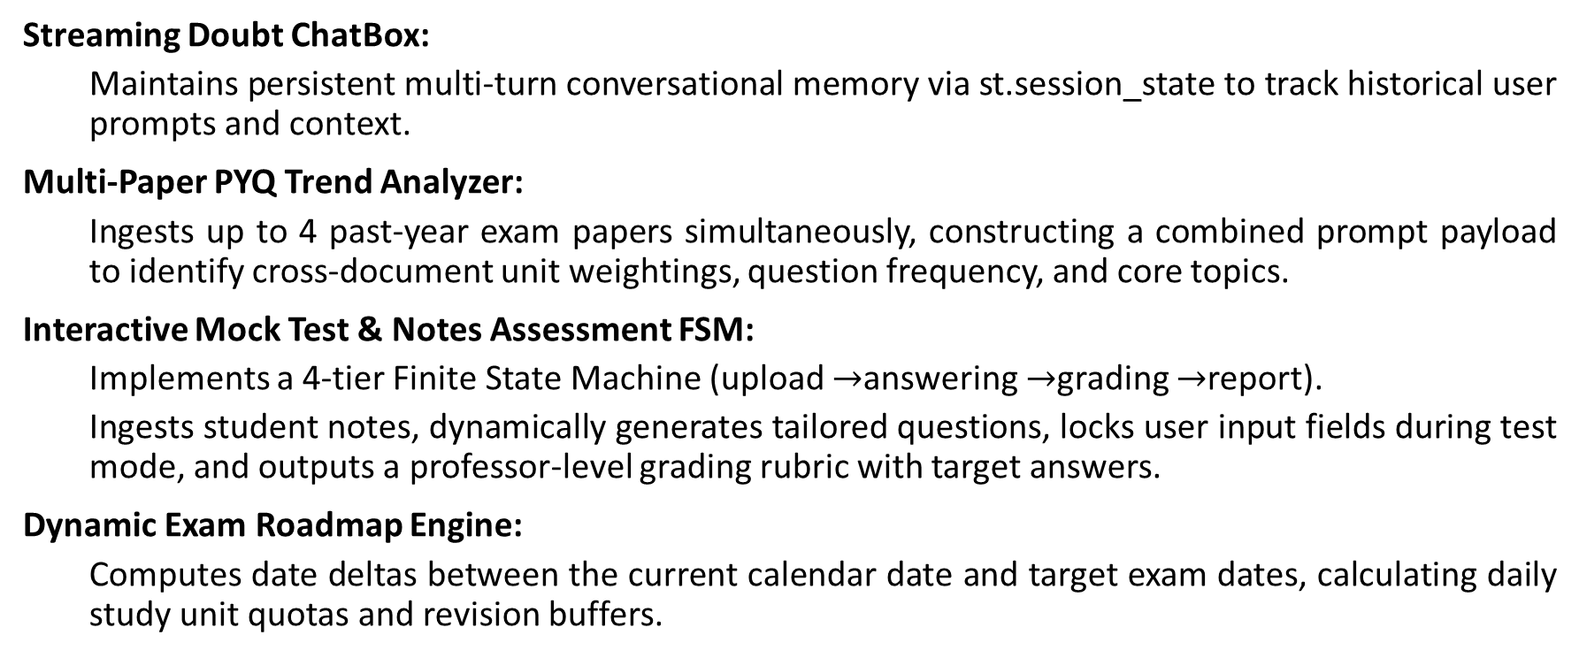
Methodology Used / Course Description
Streaming Doubt ChatBox:
Maintains persistent multi-turn conversational memory via st.session_state to track historical user prompts and context.
Multi-Paper PYQ Trend Analyzer:
Ingests up to 4 past-year exam papers simultaneously, constructing a combined prompt payload to identify cross-document unit weightings, question frequency, and core topics.
Interactive Mock Test & Notes Assessment FSM:
Implements a 4-tier Finite State Machine (upload $→$answering $→$grading $→$report).
Ingests student notes, dynamically generates tailored questions, locks user input fields during test mode, and outputs a professor-level grading rubric with target answers.
Dynamic Exam Roadmap Engine:
Computes date deltas between the current calendar date and target exam dates, calculating daily study unit quotas and revision buffers.

Slide 10
Results
Low-Latency Streaming Response:
Achieved sub-second initial token delivery (First Byte Time <1.2s) across conversational queries using the streaming API pipeline.
Maintained seamless multi-turn conversation flow with context retention across extended chat sessions.
Multi-Format Processing Efficiency:
Successfully ingested and parsed multi-page PDFs, .docx, .pptx, handwritten images, and lecture audio/video formats under a single processing workflow.
Multi-Paper PYQ Analytics: Combined and analyzed up to 4 past-year question papers simultaneously to extract topic weightings and high-frequency questions in under 10 seconds.
High-Accuracy Assessment & Feedback:
Handwritten Notes Evaluator: Successfully extracted key concepts from scanned student notes and automatically generated customized mock exams.
Automated Grading Accuracy: Delivered detailed, objective rubric evaluations and targeted feedback for student exam submissions across various subjects.
System Stability & Reliability:
Implemented safe_stream_generator with exponential backoff, preventing application crashes during high API load or rate-limit events.
Maintained stable remote public accessibility via PyNgrok ingress tunneling throughout continuous testing sessions.
Multilingual Audio Generation:
Generated clear MP3 audio lectures from extracted text across English, Hindi, Kannada, and French using integrated gTTS pipelines.

Slide 11
Conclusion
Project Conclusion:
Successfully developed and deployed a comprehensive, full-stack Multimodal AI Study Assistant using Streamlit, Google Gemini 2.5 Flash, and PyNgrok.
Consolidated fragmented academic workflows—including doubt resolution, document parsing, exam preparation, past paper analytics, handwritten note evaluation, and lecture audio generation—into a single unified workspace.
Demonstrated the power of combining multimodal LLMs with reactive finite state machine UI architectures to automate active learning and personalized study management.
Key Deliverables Met:
Zero-Friction Ingestion: Seamless processing of text, scans, PDFs, Office docs, audio, and video without external intermediate tooling.
Interactive Assessment: Fully functional end-to-end mock exam generation and automated grading loop for student notes.
Reliability: Built-in fault tolerance using exponential backoff retry mechanisms to ensure high availability during real-time streaming.
Future Scope & Enhancements:
Vector Database Integration: Incorporate RAG (Retrieval-Augmented Generation) with ChromaDB or FAISS for long-term semantic search over entire semester course packs.
Local Model Deployment: Add offline processing capability using open-weight models (e.g., LLaMA 3 or Qwen2-VL) for bandwidth-constrained environments.
Collaborative Study Rooms: Expand system state to support multi-user real-time study sessions and peer-to-peer flashcard sharing.

Slide 12
Q&A

Slide 13
Thank you !!

